Slide 1

IDAM Holiday Readiness 2024
Oracle Identity Governance

Slide 2
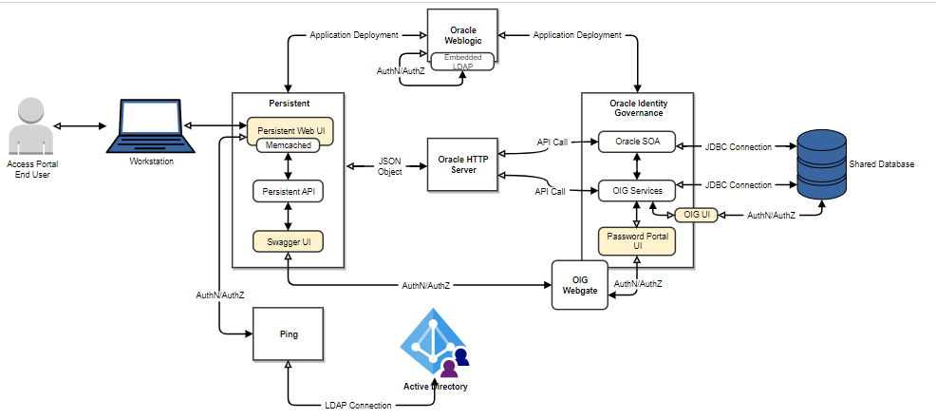
OIG Corporate Architecture

Slide 3
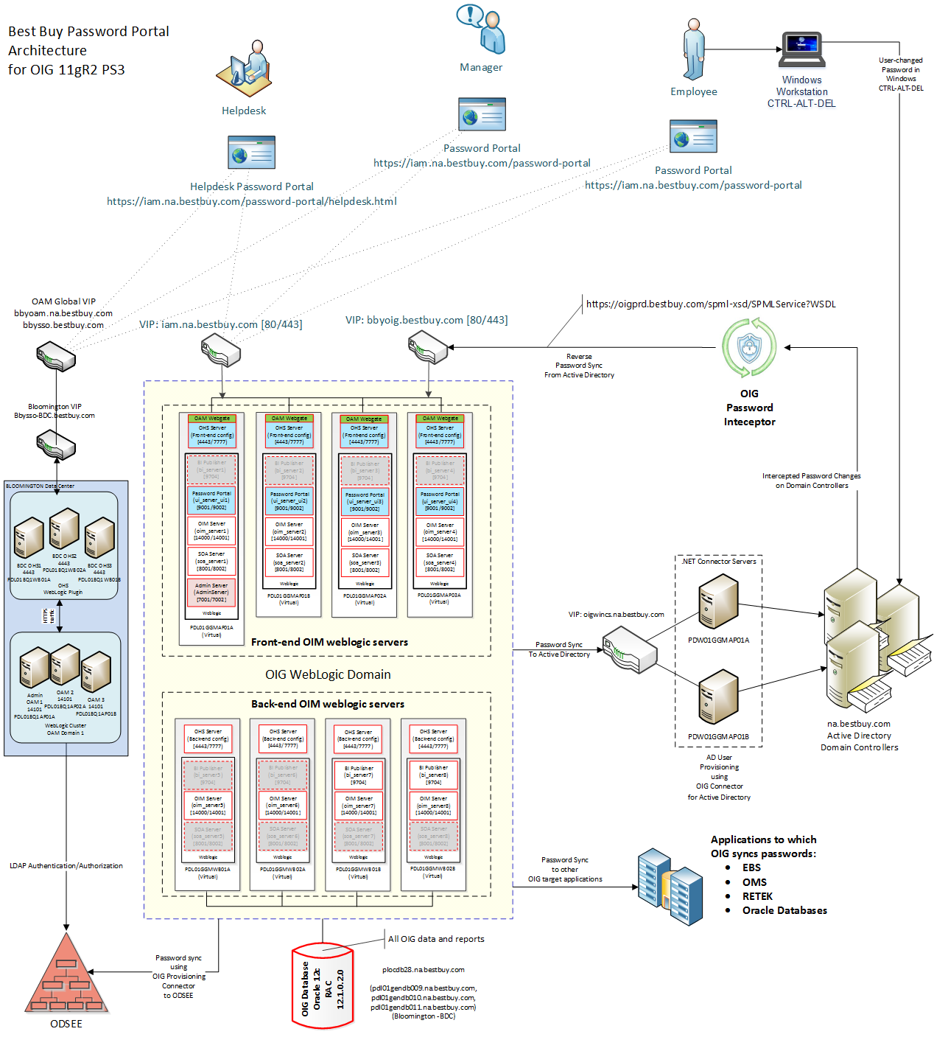
OIG Password Portal Architecture

Slide 4
OIG Password Reset Portal

Slide 5
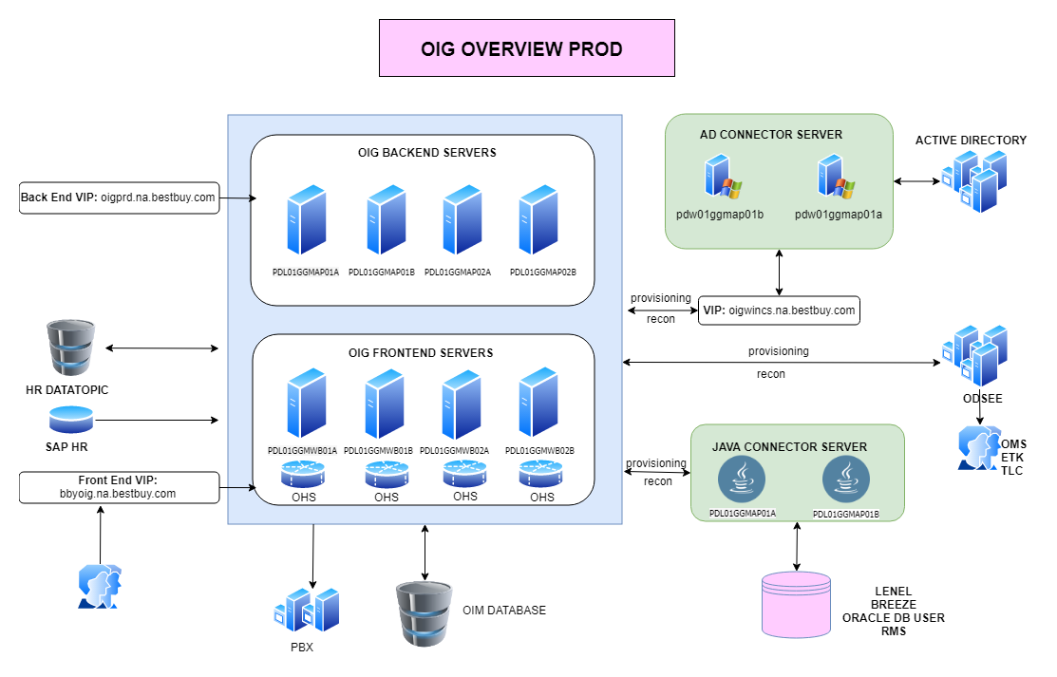
OIG Corporate Architecture

